Slide 1
Learning Objective
I will be able to use the chain rule to differentiate functions with rational powers
Success Criteria
At the end of the lesson, I will be able to:
use the chain rule to differentiate functions with rational powers

Slide 2
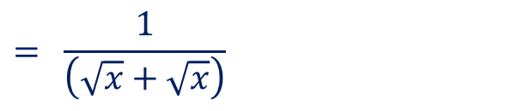
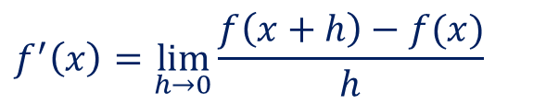
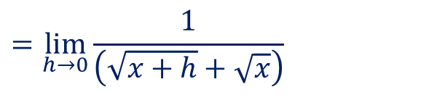
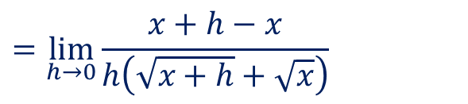

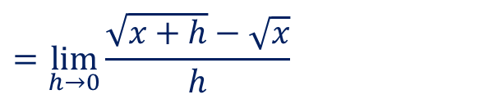
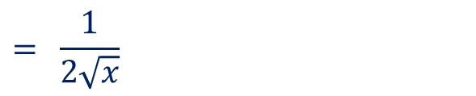
Guided Practice
Differentiate the following by first principles $f\left(x\right)=x^{\frac{1}{2}}, x>0$
$$f^{′}\left(x\right)=\lim_{h→0}{\frac{f\left(x+h\right)−f(x)}{h}}$$
$$=\lim_{h→0}{\frac{\sqrt{x+h}−\sqrt{x}}{h}}$$
$$×\frac{\sqrt{x+h}+\sqrt{x}}{\sqrt{x+h}+\sqrt{x}}$$
$$=\lim_{h→0}{\frac{x+h−x}{h\left(\sqrt{x+h}+\sqrt{x}\right)}}$$
$$=\lim_{h→0}{\frac{1}{\left(\sqrt{x+h}+\sqrt{x}\right)}}$$
$$={\frac{1}{\left(\sqrt{x}+\sqrt{x}\right)}}$$
$$={\frac{1}{2\sqrt{x}}}$$

Slide 3


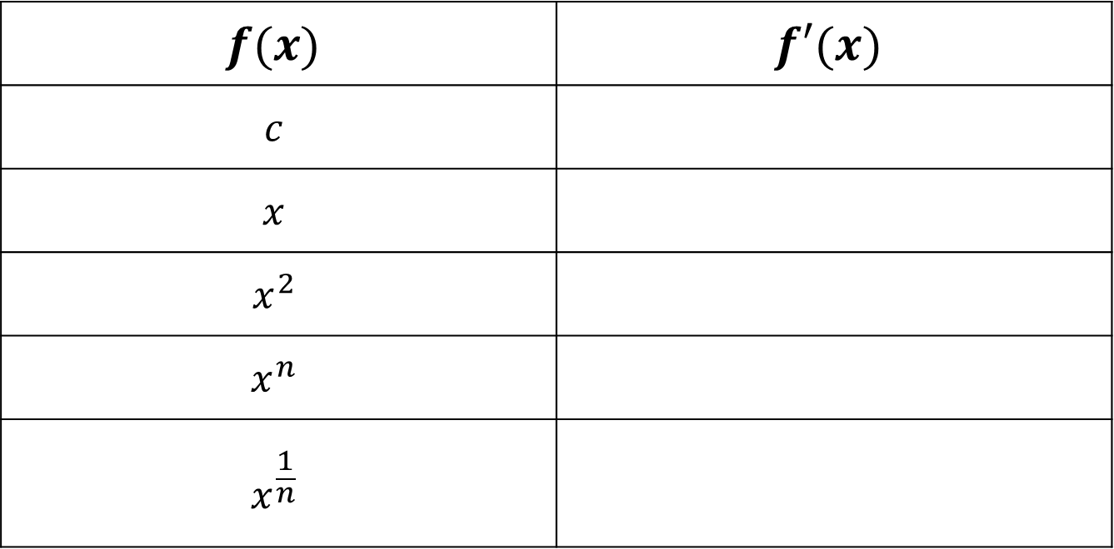



Rules of Derivative
Activating Prior Knowledge
$$f(x)$$ | $$f′(x)$$
$$c$$
$$x$$
$$x^{2}$$
$$x^{n}$$
$$x^{\frac{1}{n}}$$
$$0$$
$$1$$
$$2x$$
$$nx^{n−1}$$
$$\frac{1}{n}x^{\frac{1}{n}−1}$$

Slide 4
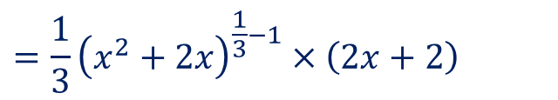
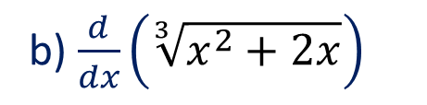
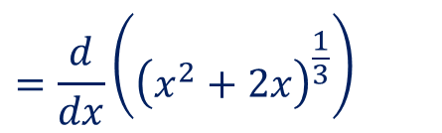
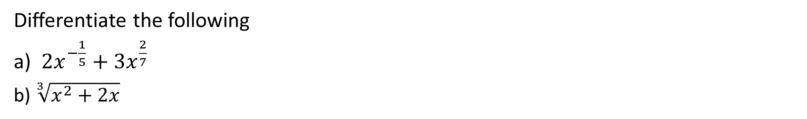
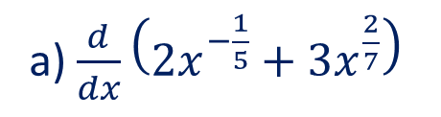
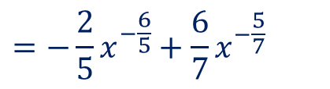
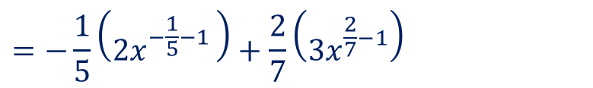
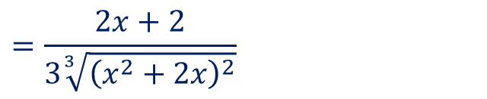
Guided Practice
Differentiate the following
a) $2x^{−\frac{1}{5}}+3x^{\frac{2}{7}}$
b) $\sqrt[3]{x^{2}+2x}$
b) $\frac{d}{dx}\left(\sqrt[3]{x^{2}+2x}\right)$
a) $\frac{d}{dx}\left(2x^{−\frac{1}{5}}+3x^{\frac{2}{7}}\right)$
$$=−\frac{1}{5}\left(2x^{−\frac{1}{5}−1 }\right)+\frac{2}{7}\left(3x^{\frac{2}{7}−1}\right)$$
$$=\frac{d}{dx}\left({\left(x^{2}+2x\right)}^{\frac{1}{3}}\right)$$
$$=−\frac{2}{5}x^{−\frac{6}{5}}+\frac{6}{7}x^{−\frac{5}{7}}$$
$$=\frac{1}{3}{\left(x^{2}+2x\right)}^{\frac{1}{3}−1}×\left(2x+2\right)$$
(Using the chain rule)
$$=\frac{2x+2}{3\sqrt[3]{{\left(x^{2}+2x\right)}^{2}}}$$

Slide 5
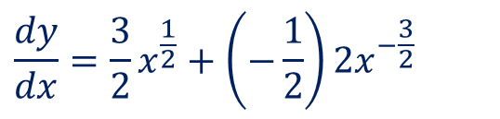
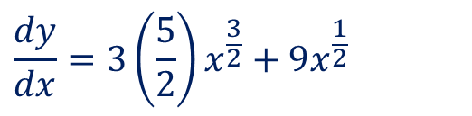
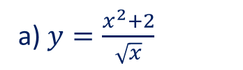


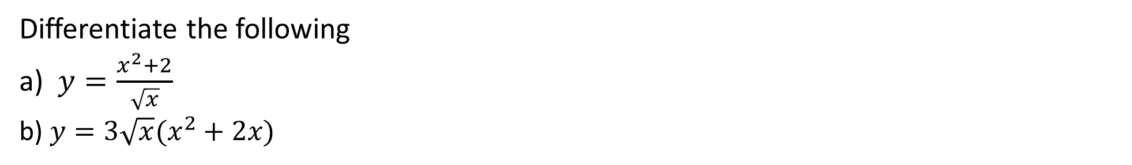


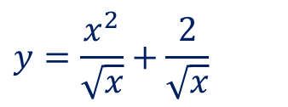
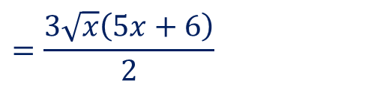

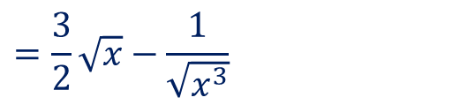
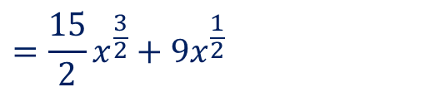
Guided Practice
Differentiate the following
a) $y=\frac{x^{2}+2}{\sqrt{x}}$
b) $y=3\sqrt{x}(x^{2}+2x)$
a) $y=\frac{x^{2}+2}{\sqrt{x}}$
b) $y=3\sqrt{x}\left(x^{2}+2x\right)$
$$=3x^{2+\frac{1}{2}}+6x^{1+\frac{1}{2}}$$
$$y=\frac{x^{2}}{\sqrt{x}}+\frac{2}{\sqrt{x}}$$
$$=3x^{\frac{5}{2}}+6x^{\frac{3}{2}}$$
$$=x^{2−\frac{1}{2}}+2x^{−\frac{1}{2}}$$
$$\frac{dy}{dx}=3\left(\frac{5}{2}\right)x^{\frac{3}{2}}+9x^{\frac{1}{2}}$$
$$=x^{\frac{3}{2}}+2x^{−\frac{1}{2}}$$
$$=\frac{15}{2}x^{\frac{3}{2}}+9x^{\frac{1}{2}}$$
$$\frac{dy}{dx}=\frac{3}{2}x^{\frac{1}{2}}+\left(−\frac{1}{2}\right)2x^{−\frac{3}{2}}$$
$$=\frac{3\sqrt{x}\left(5x+6\right)}{2}$$
$$=\frac{3}{2}\sqrt{x}−{\frac{1}{\sqrt{x^{3}}}}^{ }$$

Slide 6
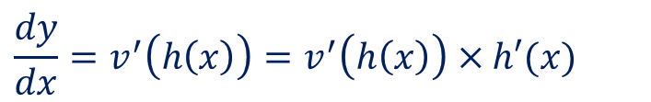
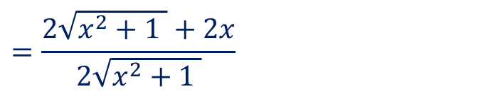
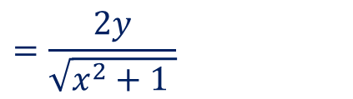

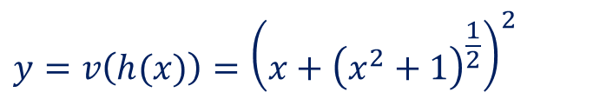
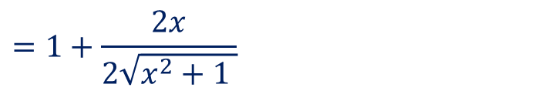
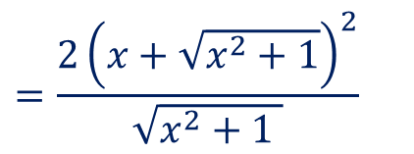
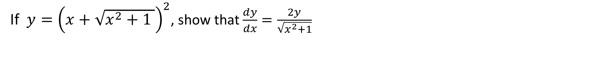
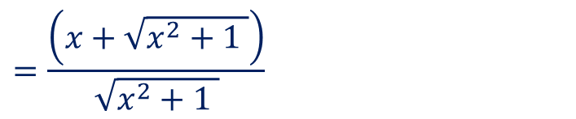

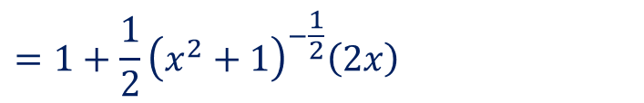
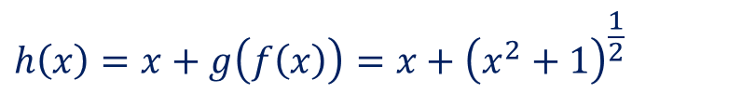
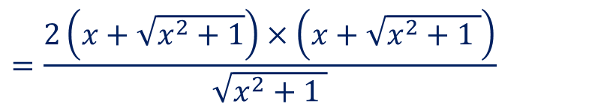


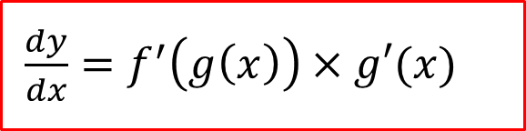
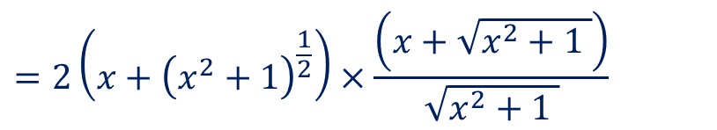
Guided Practice
$\frac{dy}{dx}=f^{′}\left(g\left(x\right)\right)×g′(x)$
If $y={\left(x+\sqrt{x^{2}+1 }\right)}^{2}$, show that $\frac{dy}{dx}=\frac{2y}{\sqrt{x^{2}+1}}$
$$f\left(x\right)=x^{2}+1$$
$$h\left(x\right)=x+g\left(f\left(x\right)\right)=x+{\left(x^{2}+1\right)}^{\frac{1}{2}}$$
$$g\left(x\right)={\left(x\right)}^{\frac{1}{2}}$$
$$h^{′}\left(x\right)=1+g^{′}\left(f\left(x\right)\right)×f^{′}\left(x\right)$$
$$v\left(x\right)=x^{2}$$
$$y=v\left(h(x)\right)={\left(x+{\left(x^{2}+1\right)}^{\frac{1}{2}}\right)}^{2}$$
$$=1+\frac{1}{2}{\left(x^{2}+1\right)}^{−\frac{1}{2}}\left(2x\right)$$
$$\frac{dy}{dx}=v^{′}\left(h\left(x\right)\right)=v^{′}\left(h\left(x\right)\right)×h′(x)$$
$$=1+\frac{2x}{2\sqrt{x^{2}+1 }}$$
$$=2\left(x+{\left(x^{2}+1\right)}^{\frac{1}{2}}\right)×\frac{\left(x+\sqrt{x^{2}+1 }\right)}{\sqrt{x^{2}+1 }}$$
$$=\frac{2\sqrt{x^{2}+1 }+2x}{2\sqrt{x^{2}+1 }}$$
$$=\frac{2\left(x+\sqrt{x^{2}+1}\right)×\left(x+\sqrt{x^{2}+1 }\right)}{\sqrt{x^{2}+1 }}$$
$$=\frac{\left(x+\sqrt{x^{2}+1 }\right)}{\sqrt{x^{2}+1 }}$$
$$=\frac{2{\left(x+\sqrt{x^{2}+1}\right)}^{2}}{\sqrt{x^{2}+1 }}$$
$$=\frac{2y}{\sqrt{x^{2}+1 }}$$

Slide 7
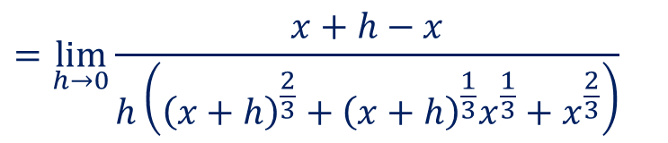
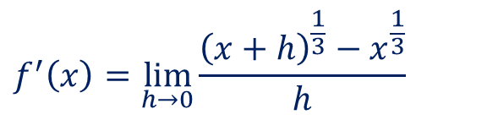
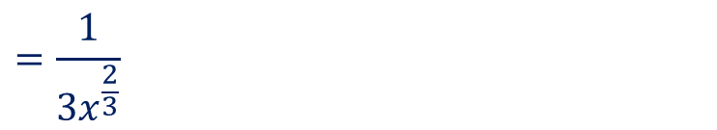
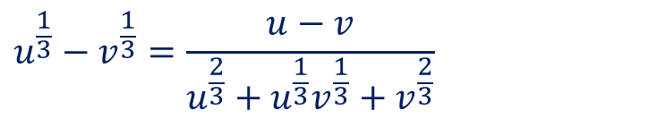
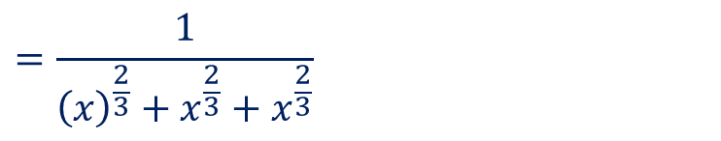

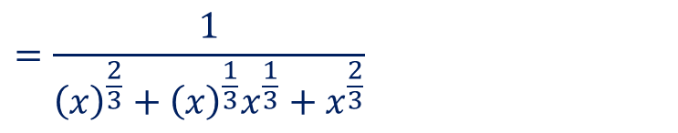
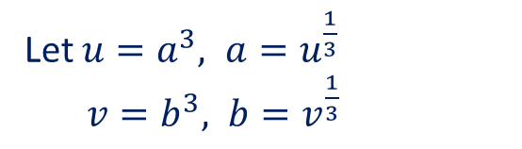
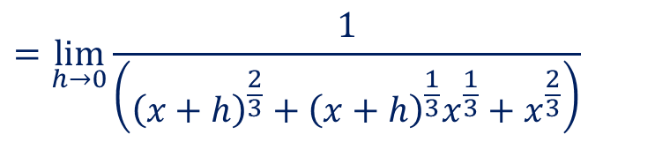
Guided Practice (Optional)
Differentiate the following by first principles $f\left(x\right)=x^{\frac{1}{3}}, x>0$
Hint: Consider $a^{3}−b^{3}=\left(a−b\right)\left(a^{2}+ab+b^{2}\right)$
Let $u=a^{3}, a=u^{\frac{1}{3}}$
$v=b^{3}, b=v^{\frac{1}{3}}$
$$f^{′}\left(x\right)=\lim_{h→0}{\frac{{\left(x+h\right)}^{\frac{1}{3}}−x^{\frac{1}{3}}}{h}}$$
$$=\lim_{h→0}{\frac{x+h−x}{h\left({\left(x+h\right)}^{\frac{2}{3}}+{\left(x+h\right)}^{\frac{1}{3}}x^{\frac{1}{3}}+x^{\frac{2}{3}}\right)}}$$
$$u−v=\left(u^{\frac{1}{3}}−v^{\frac{1}{3}}\right)\left(u^{\frac{2}{3}}+u^{\frac{1}{3}}v^{\frac{1}{3}}+v^{\frac{2}{3}}\right)$$
$$u^{\frac{1}{3}}−v^{\frac{1}{3}}=\frac{u−v}{u^{\frac{2}{3}}+u^{\frac{1}{3}}v^{\frac{1}{3}}+v^{\frac{2}{3}}}$$
$$=\lim_{h→0}{\frac{1}{\left({\left(x+h\right)}^{\frac{2}{3}}+{\left(x+h\right)}^{\frac{1}{3}}x^{\frac{1}{3}}+x^{\frac{2}{3}}\right)}}$$
$$=\frac{1}{{\left(x\right)}^{\frac{2}{3}}+{\left(x\right)}^{\frac{1}{3}}x^{\frac{1}{3}}+x^{\frac{2}{3}}}$$
$$=\frac{1}{{\left(x\right)}^{\frac{2}{3}}+x^{\frac{2}{3}}+x^{\frac{2}{3}}}$$
$$=\frac{1}{3x^{\frac{2}{3}}}$$

Slide 8
Independent Practice
Complete Cambridge Ex 4F

